Slide 1
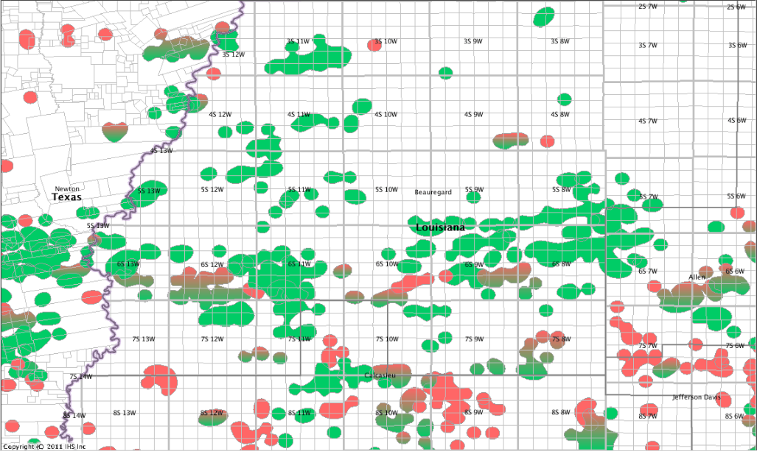
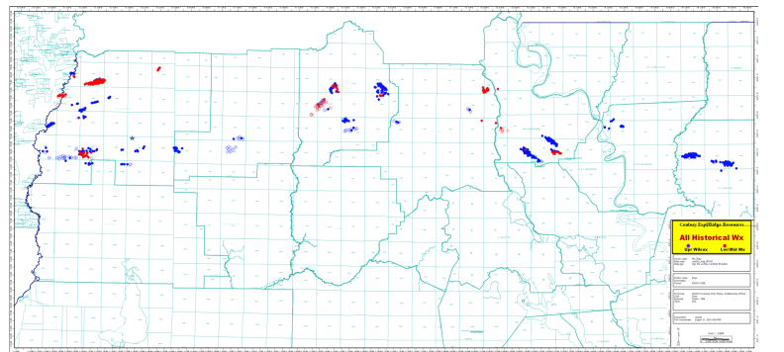
Wx: Western La Permitting Drilling Activity
11-1-2012
Union Gas Op–Doornbos-Mcpherson 1
Report Date: 4/30/12
Status: W/O Test
PTD: 16,000
17011211290000
NEW Updates on Drilling Location Drilling Locations
Oil Field Not Reported
Gas Field Oil Gas Field
Midstates – CKX Lands 27-34 HC 1ALT
Report Date: 10-26-2012
Status: Initial Report
PTD: 11000
7011211600000
Luca Op- Crosby 1
Report Date: 10/9/2012
Status: Initial Report
PTD: 13594
17011211570000
EP Energy – Brown Timber 11
Report Date: 7/29/11
Status: Initial Report – not rptd SONRIS
PTD: 15,000
EP Energy – Doornbos 36-1
Report Date: 9/26/2012
Status: Initial Report
PTD: 15000
17011211550000
Fort Apache Energy- Joseph Hudson 1
Report Date: 9/4/2012
Status: W/O Test
PTD: 11423
17003205750000
Halcon – Indigo II Op 1
Report Date: 9/27/2012
Status: Initial Report
PTD: 11000
17011211560000
EP Energy – BP 6-1
Report Date: 10/1/2012
Status: Drilling @ 13325
PTD: 15,100
17011211180000
EP Energy – Forestar 8-1
Report Date: 12/15/11
Status: W/O Test
PTD: 13,900
17011210980000
Midstates – CKX Lands 27-2
Report Date: 6/11/2012
Status: W/O Test
PTD: 16,500
17011211450000
EP Energy – BP 31 3ALT
Report Date: 9/24/2012
Status: Initial Report
PTD: 15100
17011211540000
EP Energy – PWK 10-1
Report Date: 5/16/12
Status: W/O Test
PTD: 15,000
17011211350000
Marlin Onshore – Quatre 1
Report Date: 10/11/2012
Status: Initial Report
PTD: 13594
17011211580000
EP Energy – McPherson 35-1
Report Date: 6/11/12
Status: W/O Test
PTD: 15,000
17011211420000
EP Energy – PWK 8-1
Report Date: 4/11/2012
Status: Initial Report
PTD: 15,000
17011211440000
EP Energy– Olympia 4-4ALT
Report Date: 10/10/2012
Status: Permit Expired
PTD: 15000
17011211170000
Midstates – McFatter 8 H-1
Report Date: 10/25/2012
Status: Initial Report
PTD: 12000
17011211590000
Midstates – Bel Mineral 16-1
Report Date: 6/15/2012
Status: Initial Report
PTD: 16,000
17003205740000
W. Gordon
EP Energy – Fisher-Lindsey 9-2alt
Report Date: 9/28/2012
Status: Initial Report
PTD: 15435
17077211120000
See Next Slide for Details
EP Energy – Olympia 10-2
Report Date: 10/2/12
Status: Permit Expired
PTD: 15,000
17011210860000
Midstates – Farms 7-1
Report Date: 5/22/12
Status: W/O Test
PTD: 14,700 recompleting
17011211010000
Duncan Oil – Meriwether 36-1
Report Date: 10/1/2012
Status: Drilling @ 6925
PTD: 7900
17019223090000
Mayne & Mertz – Burlington 7
Report Date: 9/26/2012
Status: Initial Report
PTD: 8000
17019223120000
Shoreline SE – Douget etal 3
Report Date: 10/1/2012
Status: W/O Test
PTD: 8881
17053214640000

Slide 2
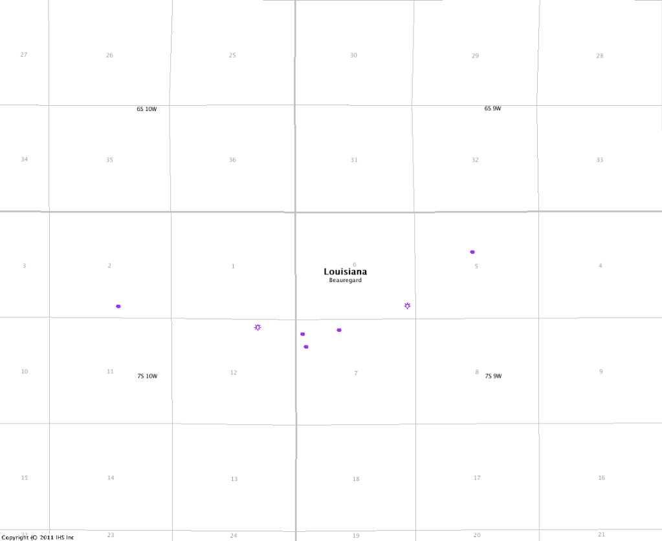
West Gordon Area
Drilling
Wx RD SUA
Johnson
Midstates – AKS Pro etal 5H1
Report Date: 9/4/2012
Status: W/O Test
PTD: 14178
17011211180000
Midstates – Forestar 12-2
Report Date: 3/19/12
Status: W/O Test
PTD: 13,600
17011211360000
Midstates – Forestar Min 7-1
Report Date: 10/1/2012
Status: sidetrack and deepen
PTD: 13088
17011210770000
NEW Updates for Drilling Locations
Drilling Location
2011 Completions

Slide 3
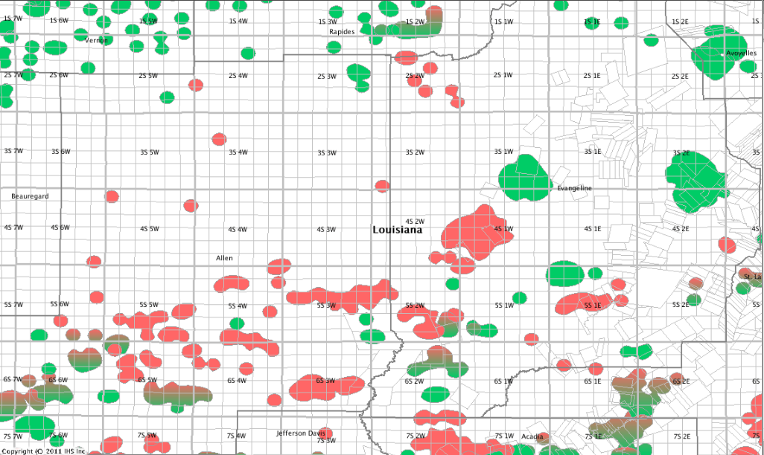
Wx: Central La Permitting Drilling Activity
11-1-2012
Hilcorp – McDaniel 10
Report Date: 3/26/12
Status: W/O Test
PTD: 9,760
17039205230000
Century Exp – Evangeline Sec Co 1
Report Date: 2/17/12
Status: Initial Report
PTD: 14,400
17039205190000
Hilcorp – Fontenot 2&3-11
Report Date: 4/23/12
Status: W/O Test
PTD: 11,625
17039205240000
Endeavor – RN Min 1
Report Date: 9/26/2012
Status: Initial Report
PTD: 10000
17003205760000
Midstates - R Dougia #6
Report Date: 6/4/12
Status: W/O Test
PTD: 13,100
17039205220000
Midstates – Eunice Canal 31-1
Report Date: 2/6/12
Status: Drilled to 10,579
OPERATION SUSPENDED
PTD: 11,400
17039202340000
Union Gas – O’Neal 1
Report Date: 2/6/12
Status: W/O Test
PTD: 7,700
17003205700000
Updates on Drilling Location
Drilling Location
Oil Field
Not Reported
Gas Field
Oil Gas Field
TOCE Energy – Lavergne 1
Report Date: 5/10/12
Status: W/O Test
PTD: 7,650
17039205200000
Gulf South (G064) – J. Bentley
Report Date: 5/16/11
Status: W/O Test
PTD: 11,050
17003205620000
Mcgowan Working – Guillory Younge etal 1
Report Date: 7/2/2012
Status: Drilling @ 9459
PTD: 9350
17097210800000

Slide 4
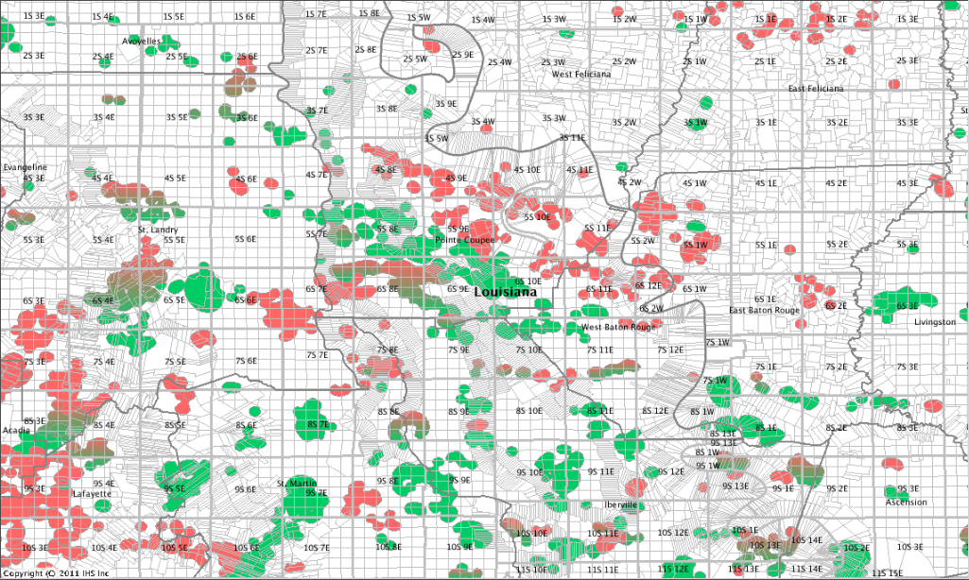
1S-3W-63
Devon – Murphy 63H-1
Report Date: 7/9/2012
Status: W/O Test
PTD: TMS/ V- 14200 H-19200
17125201310000
Vaquero Energy – Mooney #1
Report Date: 11/28/11
Status: Drilling @ 5967
PTD: 10,000
17125201300000
Vaquero Res – Rapier 1
Report Date: 12/27/11
Status: Drilling @ 9,984
PTD: 9990
17037201550000
Hilcorp – 19000 Tusc RB 1
Report Date: 10/29/2012
Status: Drilling @ 19475
PTD: 21200
17097209820000
Neumin Prod – Helouin Prop 1
Report Date: 6/11/12
Status: Drilling @ 5,946
PTD: 12,000
17017206100000
Key Op- Thisco Part 6
Report Date: 10/8/2012
Status: Drilling @ 8428
PTD: 9990
17097210770000
New Century – Decker Farms 1
Report Date: 5/18/12
Status: W/O Test
PTD: 10,500
17033203020000
Neumin Prod – Kimball Jr 31-1
Report Date: 1/26/12
Status: Initial Report
PTD: 11,800
17077260900000
TOCE Energy – Futral B 7
Report Date: 10/29/2012
Status: Drilling @ 5528
PTD: 5500
17097210820000
Northwind – Marlborough 3
Report Date: 10/1/2012
Status: W/O Test
PTD: 9250
17121202230000
Northwind Oil – Winthrop 11
Report Date: 4/16/12
Status: W/O Test
PTD: Unknown/Deepening
Northwind– Marlborough O&G 3
Report Date: 7/11/2012
Status: Initial Report
PTD: 9306
17121202230000
Expert oil – Wilberts Sons LLC 1
Report Date: 8/31/2012
Status: Initial Report
PTD: 11418
17047210970000
NEW Updates on Drilling Location Drilling Locations
Oil Field Not Reported
Gas Field Oil Gas Field
Cypress Prod– Begnaud 1
Report Date: 5/21/12
Status: W/O Test
PTD: 10,700
17097210780000
Northwind Oil – Wilbert Min 94
Report Date: 10/28/11
Status: Initial Report
PTD: 9,099
17047211050000
Wx: Eastern La Permitting Drilling Activity
11-1-2012

