Slide 1
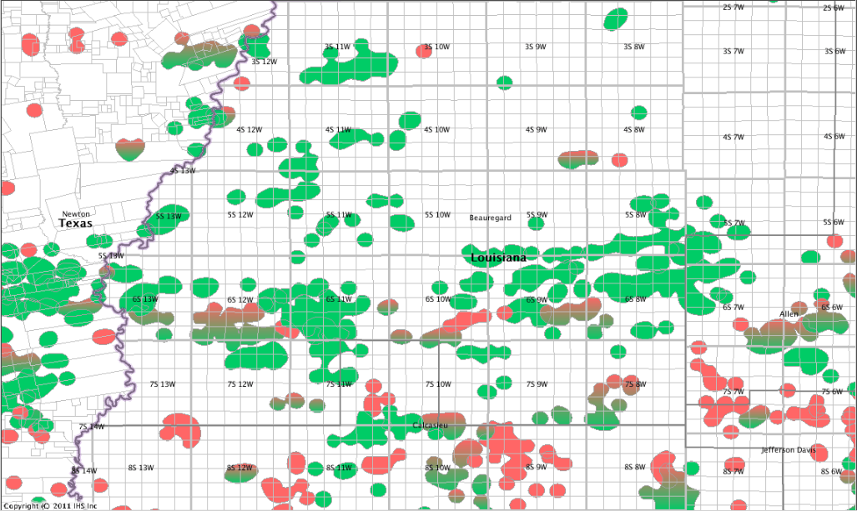
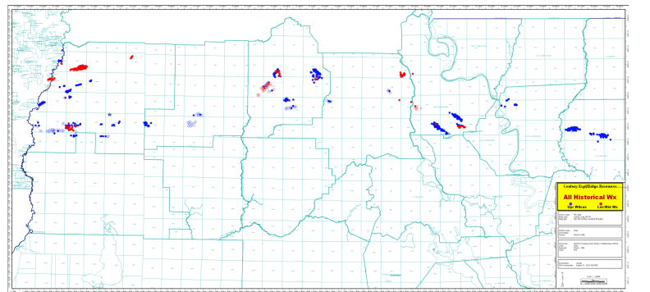
Recent Completions
Completions
Oil Field Not Reported
Gas Field Oil Gas Field
Cortex – Musser-Davis c5
Report Date: 7/2/12
IP:Future Utility
TD: 7020
Obj: NA
Perf: NA
17011211280000
Wx: Western La Completions
11-1-2012
EP Energy– BP 6-1
Report'd: 10/19/2012
IP: Future Utility – Stuck tool
Obj/ Perf: Lwr Wx?
TD: 13600
17011211530000
Riceland – Bailey 1
Report Date: 8/23/2012
IP: 150 BCPD, 1 MCFD
TD: 12068
Obj: Upr Wx/
Perf: 8584-8587
17011211220000
EP Energy– BP 32 2 ALT
Report'd: 9/12/2012
IP: 23 BCPD, 1127 MCFD
Obj/ Perf: Lwr Wx/ 12386-13375
Report'd: 10/10/2012
IP: 20 BCPD, 264 MCFD
Obj/ Perf: Lwr Wx/ 12768-13234
TD: 15000
17011211520000
EP Energy– BP 33-1 ALT
ReComp’d: 4/12/12
IP: 214 BCPD + 2720 MCFD
Obj/ Perf: Basal Upr Wx 11,402-13,804
ReComp’d: 2/10/12
IP: 224 BCPD + 2909 MCFD
TD: 14,017
Obj/ Perf: Basal Upr Wx 11,402-13,804
Report’d: 1/3/12
IP: 73 BCPD, 634 MCFD
Obj/ Perf: 13,094-13,804
17011211210000
Swift Energy – A H Irby 1
Report Date: 7/25/12
IP:18.4 BOPD, 45 BWPD
TD: 15457
Obj: Lwr Wx
Perf: 13184-13194 & 13062-13070
17011200260000
Indian Epl. – Riceland A-3
Report Date: 6/18/2012
IP: Shut-in Dry Hole
TD: 7,200
Obj/ Perf: N/A
17011211160000
Exodus – Olympia 1
Report'd: 10/2/2012
IP: 24 BOPD, 550 MCFD
Obj/ Perf: Ckfld/ 8007-8012
TD: 8850
17011211470000
Midstates – Musser-Davis 33-11
Report Date: 7/30/12
IP: 50 BOPD, 208 MCFD, 490 BWPD
TD: 12022
Obj: Upr Wx
Perf: 10894-11220
17011211400000
EP Energy– BP 32 2 ALT
Report'd: 9/20/2012
Status: Future Utility
Obj/ Perf: NA
TD: 15000
17011211520000
El Paso – Forestar Min 11-1
Report Date: 5/22/12
IP: 59 BCPD + 14 MCFD
TD: 15,000
Obj/ Perf: Lwr Wx/ 11,384-13,226
17011211000000
EP Energy – Olympia 23-1
Report Date: 6/29/12
IP:115 BOPD, 81 MCFD
TD: 11630
Obj: Upr Wilcox
Perf: 10,576-10,740
17011211430000
Halcon– Columbia L&T 9-1
Report'd: 9/6/2012
IP: 175 BOPD, 220 MCFD
Obj/ Perf: Upr Wx/ 9708-9860
TD: 14500
17011211240000
Midstates – Musser-Davis 33-5
Report'd: 4/16/12
IP: 500 BOPD + 3000 MCFD
TD: 15,035
Obj/ Perf: Top Mid Wx/11,666-11,686
17011210650000
El Paso – Anita MidKiff 33-1
Report'd: 2/28/12
IP: 3.1 BCP + 0 MCFD
TD: 12,800
Obj/ Perf: Mid Wx/ 10,647-10,810
17011211100000
EP Energy– Van Winkle 22-1
Report'd: 2/14/12
IP: 700* BCPD + 189 MCFD
TD: 15000
Obj/ Perf: Basal Upr Wx/ 10,784-10,864
* As Per Randy Allmon
17011211200000
Midstates – CKX Lands 27-1
Report'd: 5/7/12
IP: 532 BOPD+ 1205 MCFD
TD: 15300
Obj/ Perf: Lwr Wx/ 13,456-14,756
17011211310000
EP Energy– Columbia Land 28-1
Report Date: 5/18/12
IP: 210 BCPD+1500 MCFD
TD: 15,100
Obj/ Perf: Mid Wx/ 11,600-12,290
17011211300000
Midstates – Musser-Davis 33-10
Report'd: 2/29/12
IP: 1000 BOPD, 71 MCFD
TD: 14,250
Obj/ Perf: Basal Upr Wx/ 12958-13700
17011211250000
El Paso – Miller 11-1
Report'd: 2/3/12
IP: 405 BCP + 128 MCFD
TD: 15,000
Obj/ Perf: Lwr Wx/ 10,988-11,004
17011211110000
EP Energy– Olympia 5-1
Report'd: 5/7/12
IP: Unsuccessful recomp
Obj/ Perf: 8462-8464
RECOMP Report'd: 6/30/2012
IP: 423 MCFD, 23 BCPD
TD: 15,100
Obj/ Perf: Mid Wx/ 12,440-13,486
RECOMP Report'd: 9/21/2012
IP: 157 BCPD, 1145 MCFD
Obj/ Perf: Lwr Wx/ 13441-13695
RECOMP Report'd: 10/25/2012
IP: 89 BCPD, 413 MCFD
Obj/ Perf: Lwr Wx/ 12752-13695
17011210800000
W. Gordon
Union Gas – Val Miller 1
Report'd: 10/2/2012
Status: Future Utility
Obj/ Perf: N/A
TD: 10600
17077211510000
Midstates – CKX Lands 32-1
Report'd: 4/19/12
IP: 430 BOPD + 2500 MCFD
TD: 13,700
Obj/ Perf: Mid Wx/ 11,360-11,540
17011211150000
See Next Slide
for Details
Midstates – AKS Pro etal 5H1
Report'd: 9/4/2012
IP: 307 BOPD, 1425 MCFD
Status: well shut-in as of 7/30/12
TD: V-13463 H-16695
Obj/ Perf: Wx/ 13794-16624
17011211180000
Midstates –Musser-Davis 34-2
Report'd: 4/16/12
IP: 20 BOPD + 15 MCFD
TD: 11,740
Obj/ Perf: Mid Wx/ 11,590-11,226
17011210570000
EP Energy– Olympia 20-3
Report'd: 2/24/12
IP: 323 BCPD,+ 983 MCFD
TD: 13,500
Obj/ Perf: Upr Wx/ 12,022-12,544
EP Energy– Musser-Davis 8H-1
Report'd: 9/20/2012
IP: 700 BOPD, 1100 MCFD
Obj/ Perf: Upr Wx/ 12078-14204
TD: 14273
17011211480000
EP Energy– Olympia 4-3 ALT
Report'd: 2/14/12
IP: 480 BCPD + 2146 MCFD
TD: 15,000
Obj/ Perf: Mid Wx/ 12,297- 13,639
17011211260000
Midstates – Musser-Davis 33H-1
Report Date: 5/21/12
IP: 500 BOPD + 70 Mcf
TD: V-5100 H-7100
Obj/ Perf: Frio/ 4,950-5,100
17011211390000
Midstates – Musser-Davis 34-3
Report'd: 9/4/2012
IP: 400 BOPD, 470 MCFD
TD: 15606
Obj/ Perf: Lwr Wx/ 13694-14300
17011211460000
Midstates – Musser-Davis 33-4 ALT
Report'd: 10/29/2012
IP: 584 BOPD, 3100 MCFD
Obj/ Perf: Upr Wx/ 11666-11684
TD: 15035
17011210630000
Duncan– Brown etal 1
Report'd: 5/8/12
IP: 384 BOPD + 147 MCFD
TD: 7,510
Obj/ Perf: 7,098 -7,102
17019222860000

Slide 2
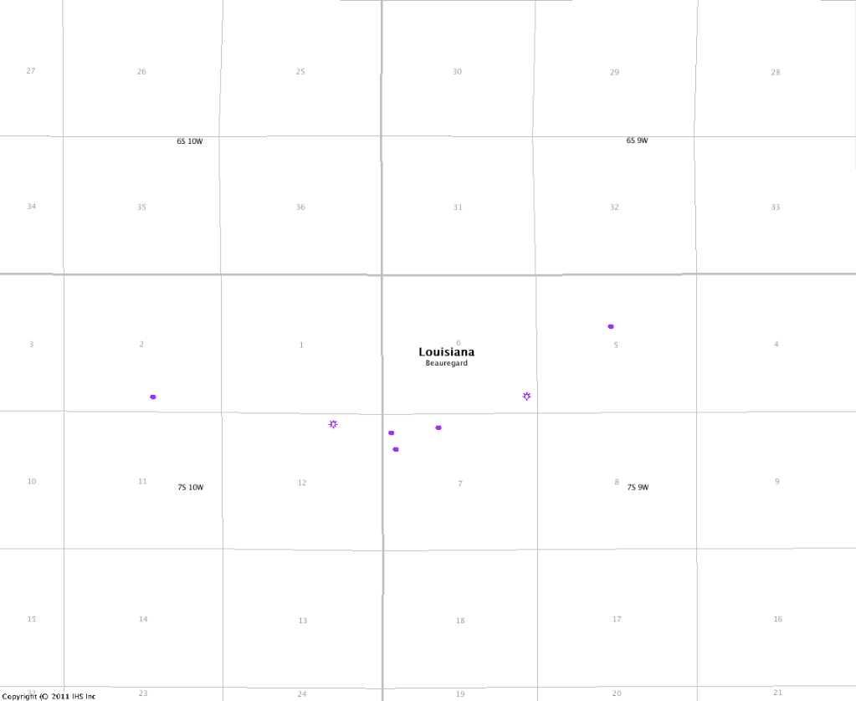
Recent Completions
Completions
West Gordon Area
Midstates – McNiel 4-1
Report'd: 7/30/2012
IP: 225 BOPD, 874 MCFD
TD: 14600
Obj/ Perf: 13042-13522
17011211340000
Midstates – Benton 5-1
Report'd: 7/3/12
IP: 20 BOPD + 11 MCFD
TD: 14002
Obj/ Perf: 12916-13800
17011211410000
Wx RD SUA
Midstates – Forestar 1-1
Report'd: 3/9/12
IP: 200 BOPD + 160 MCFD
TD: 13600
Obj/ Perf: 12642-13380
17011211080000
Johnson
Midstates – Forestar 5-2
Report'd: 3/30/12
IP: 100 BOPD + 94 MCFD
TD: /13700
Obj/ Perf: 13160-13510
17011211140000
Midstates – AKS 5-1
Report'd: 3/22/12
IP: 307 BOPD + 1425 MCFD
TD: V-13463 H-16695
Obj/ Perf: 13794-16624
17011211180000

Slide 3
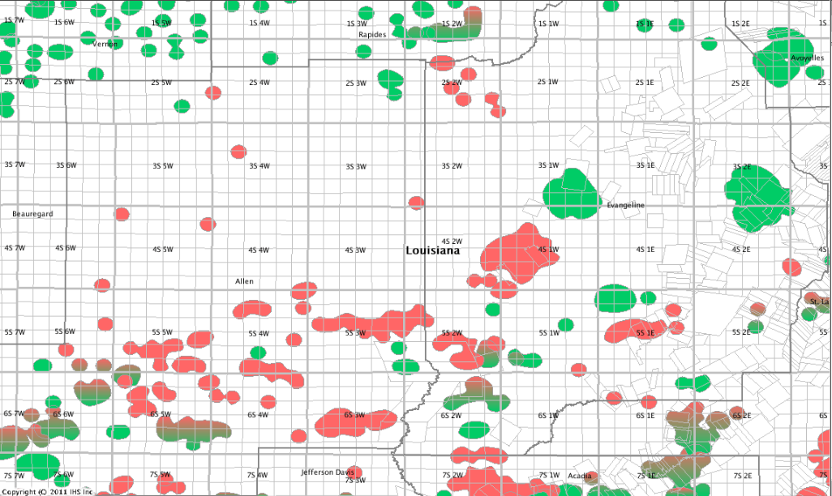
Wx: Central La Completions
11-1-2012
Recent Completions
Completions
Oil Field Not Reported
Gas Field Oil Gas Field
Swift– Exxon Corp 10 1ALT
Report'd: 2/13/12
IP: 0 BOPD + 5880 MCFD
TD: Horizontal/17223
Obj/ Perf: Aus Chlk/ 14876-17223
17115202170000
Addison Oil – Crosby 5-1
Report'd: 4/5/12
IP: 46 BOPD + 233 MCFD
TD: 19718
Obj/ Perf: Aus Chlk/15000-15787
17115201680000
Ventex – Roy O Martin 21-1
Report'd: 10/8/2012
IP: 661 MCFD
TD: 3007
Obj/ Perf: Miocene/ 2706-2712
17039205520000
See Next Slide for Details
Union – SSS&F Farm 1
Report'd: 2/13/12
IP: Dry & Plugged
TD: 10,000
Obj/ Perf: Cockfield?/ N/A
17003205710000
Hilcorp– Ortego 2
Report'd: 5/7/12
IP: Future Utility
TD: 8500
Obj/ Perf: Frio/ 9954-9964
17039202890000
Indian – Joseph Haas 2
Report'd: 7/2/12
IP: 20 BOPD,
TD: 6750
Obj/ Perf: 6620-6622
17039204740000
Pine Prairie
Ventex – Godwin Estate 1
Report'd: 1/4/12
IP: Future Utility
TD: 17150
Obj/ Perf: Lwr Wx?/ N/A
17039205070000
Midstates- Moreau 17-1
Report'd: 8/23/2012
IP: 500 BOPD, 1034 MCFD
TD: 15575
Obj/ Perf: Upr Mid Wx/ 14498-15350
17003205730000
Midstates – Bel Min 18-1
Report'd: 1/21/12
IP: 278 BPD + 1400 MCFD
TD: 16000
Obj/ Perf: Lwr Wx/14342-14687
17003205690000
LA Land & Expl – Stokes 1 Recomp
Report'd: 7/25/12
IP: 14 BCPD, 61 MCFD
TD: 13830
Obj/ Perf: 10598-11340
17039200770000
Shoreline SE – Douget etal 2
Report'd: 5/7/12
IP: 378 BOPD + 1672 MCFD
TD: 8850
Obj/ Perf: Frio/ 8388-8402
17053214610000
TOCE Energy– Landreneau 2
Report'd: 5/8/12
IP: 0 BOPD + 1300 MCFD
TD: 7553
Obj/ Perf: Frio/ 7545-7550
17039201600000
Zachry Expl – Young 1
Report'd: 4/17/12
IP: 66 BOPD + 62 MCFD
TD: 8500
Obj/ Perf: 8151-8166
17039205120000
Midnight – Brawner 1
Report'd: 3/13/2012
IP: 5 BOPD + 300 BWPD
TD: 7852
Obj/ Perf: Frio/ 6876-6878
17003003490000
Midstates – Eunice Canal 31-2
Report'd: 9/4/2012
IP: 35 BCPD, 356 MCFD
TD: 11458
Obj/ Perf: Sparta/ 10710-11214
17039205270000
Union Gas – Meriwether 1
Report'd: 4/20/12
IP: 142 BOPD + 490 MCFD UNSUCCESSFUL
TD: 13000
Obj/ Perf: 13006-13034
17003205720000
Five JAB Inc – Lafleur B1
Report'd: 6/4//12
IP: Unsuccessful
TD: 8649
Obj/ Perf: Frio/ 8074.5-8075.5
17039202020000
Shoreline SE – King Min 1
Report'd: 7/31/12
IP: 4120 MCFD, 302 BCPD
TD: 9100
Obj/ Perf: HBY/ 8885-8889
17053214600000
Will-Drill Op- Vit etal 23-1
Report'd: 9/18/2012
IP: 2 BCPD, 1287 MCFD
TD: 8700
Obj/ Perf: Oligocene/ 6220-6223
17003205440000
29-7S-6W
36-7S-6W

Slide 4
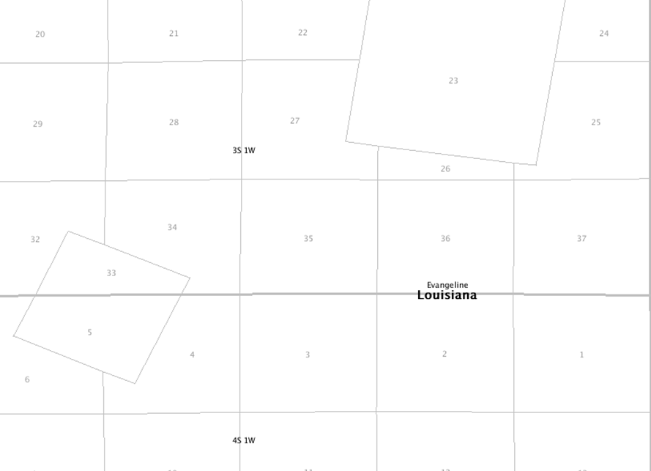
Pine Prairie Field
Midstates – Crowell 27-9
Report'd: 9/20/2012
IP: 500 BOPD, 270 MCFD
TD: 11078
Obj/ Perf: Upr Wx/ 10644-11022
17039205480000
Inexco – CL&M 22 Recomp
Report'd: 7/25/12
IP: 5 BOPD, 2 MCFD
TD: 11900
Obj/ Perf: Wx/ 9221-9241
017039205210000
Midstates - Crowell 35-7
Report'd: 2/26/12
IP: 825 BOPD + 400 MCFD
TD: 6,115
Obj/ Perf: 5,260-5,352
17039205140000
Midstates - Johnson Etal 35-5
Report'd: 5/29/12
IP: 1482 BOPD + 2024 MCFD
Obj/ Perf: 8,556-8,696
Report'd: 5/7/12
IP: Future Utility
TD: Wx/12,000
17039205160000
Recent Completions
Completions
Midstates - Crowell 27-7
Report'd: 6/14/2012
IP: 400 BOPD + 1569 MCFD
TD: 11,000
Obj/ Perf: 10,608-10,876
017039205210000
Midstates – Crowell 35-9
Report'd: 9/4/2012
IP: 600 BOPD, 2700 MCFD
TD: 6040
Obj/ Perf: Frio/ 5366-5418
17039205540000
Midstates – McDaniel 2
Report'd: 10/2/2012
Satus: Future Utility
TD: 11404
Obj/ Perf: N/A
17039205470000
Midstates – McDaniel 2
Report'd: 10/23/2012
IP: 14 BOPD, 26 MCFD
TD: 11404
Obj/ Perf: Upr Wx/ 10714-10836
17039205470000
Midstates – Crowell 27-13
Report'd: 9/20/2012
IP: 350 BOPD, 550 MCF
TD: 11510
Obj/ Perf: Upr Wx/ 11083-11406
17039205590000
Inexco – CL&M 22
Report'd: 9/24/2012
IP: 431 BOPD, 147 MCFD
TD: 11859
Obj/ Perf: ?/ 9221-9700
17039204120000
Inexco – CL&M Corp 3 Recomp
Report'd: 7/25/12
IP: 6 BOPD, 5 MCFD
TD: 9300
Obj/ Perf: Upr Wx/ 9178-9220
017039205210000
Midstates – Crowell 26-1
Report'd: 10/19/2012
IP: 324 BOPD, 1971 MCFD
TD: 11000
Obj/ Perf: Wx/ 10608-10876
17039204880000
Midstates – Perkins 34-5
Report'd: 7/31/2012
IP: 78 BOPD, 172 MCFD
TD: 11839
Obj/ Perf: Upr Wx/ 11064-11438
17039205340000
Midstates – Crowell 27-10
Report'd: 9/20/2012
IP: 590 BOPD,1100 MCFD
TD: 11400
Obj/ Perf: Upr Wx/ 10916-11282
17039205490000
Midstates – Fuselier 35-1
Report'd: 7/2/12
IP: Future Utility
TD: 3034
Obj/ Perf: NA
017039205210000
Midstates – RJ Penny etal 34-2
Report'd: 7/19/2012
IP: 100 BOPD, 300 MCFD
TD: 11337
Obj/ Perf: Upr Wx/ 10890-11236
017039205210000
Midstates – Indigo 28-2
Report'd: 8/1/12
IP: 130 BOPD, 422 MCFD
TD: 11580
Obj/ Perf: Upr Wx/ 11161-11366
17039205420000
Clovelly – Ledanois L&S 4
Report'd: 9/21/2012
IP: 30 BOPD, 510 MCFD
TD: 10720
Obj/ Perf: Wx/ 9914-10260
17039203880000
Midstates - Penny 34-1
Report'd: 4/24/12
IP: 295 BOPD + 618 MCFD
TD: 12,000
Obj/ Perf: Wx/ 10,820-11,284
17039205110000
Midstates - Johnson 35-4
Report'd: 4/18/12
IP: 1006 BOPD + 2397 MCFD
TD: 12,400
Obj/ Perf: Wx/ 9204-10383
17039205090000
Midstates Schlicher-Thomas 25
Report'd: 2/24/12
IP: 200 BOPD+ 30 MCFD
TD: 2,028
Obj/ Perf: Miocene/ 1,966-2,022
17039205040000
Midstates – LeBlanc 34-2
Report'd: 10/10/2012
IP: 290 BOPD, 756 MCFD
TD: 11450
Obj/ Perf: Upr Wx/ 10982-11272
17039205440000
Clovelly – Ledanois 1-D
ReComp’d: 3/19/12
IP: 96 BOPD + 40 MCFD
TD: 9,100
Obj/ Perf: Frio/ 5,044-5,060
17039200750000
Midstates Schlicher-Thomas 26
Report'd: 7/25/12
IP: 5 BOPD, 22 MCFD
TD: 1966
Obj/ Perf: Miocene/ 1872-1946
Report'd: 9/7/2012
IP: 453 BOPD, 70 MCFD
Obj/ Perf: Miocene/ 1418-1654
17039205050000
Midstates – Perkins 34-7
Report'd: 10/10/2012
IP: 55 BOPD, 76 MCFD
TD: 11760
Obj/ Perf: Upr Wx/ 11215-11450
17039205570000
Midstates – Schlicher-Thomas 30
Report'd: 9/4/2012
IP: 22 BOPD, 23 MCFD
TD: 2290
Obj/ Perf: Miocene Res/ 1860-1875
17039205300000
Midstates LeBlanc 34-1
Report'd: 2/22/12
IP: 48 BOPD + 268 MCFD
TD: 11,400
Obj/ Perf: Wx/ 10,684-11,034
17039205440000
Midstates LeBlanc 34-1 ALT
Report'd: 3/13/2012
IP: 48 BOPD + 268 MCFD
TD: 12,000
Obj/ Perf: Wx/ 10,684-11,034
17039205100000
Clovelly – Ledanois 5D
Report'd: 10/12/2012
IP: 30 BOPD, 40 MCFD
TD: 8865
Obj/ Perf: Frio? Ckfld?/ 6358-6366
17039204770000
Midstates – Perkins 34-5
Report'd: 7/31/2012
IP: 78 BOPD, 172 MCFD
TD: 11839
Obj/ Perf: Upr Wx/ 11064-11438
17039205340000
Clovelly – Ledanois Co 2-D
Report'd: 9/18/2012
IP: 80 BOPD, 200 MCFD
TD: 12033
Obj/ Perf: 9248-9470
17039200900000
Midstates – Crowell 35-8
Report'd: 9/4/2012
IP: 47 BOPD, 127 MCFD
TD: 6094
Obj/ Perf: Frio/ 4822-5192
17039205450000
Clovelly – Ledanois 5-D
Report’d: 3/1/12
IP: 750 BWPD
TD: 8,865
Obj/ Perf: Frio/ 6,536-6,554
17039204770000
Midstates Schlicher-Thomas B2 ALT
Report'd: 2/6/12
IP: 480 BOPD + 2882 MCFD
TD: 10795
Obj/ Perf: Wx/ 9,486-10,316
17039205080000

Slide 5
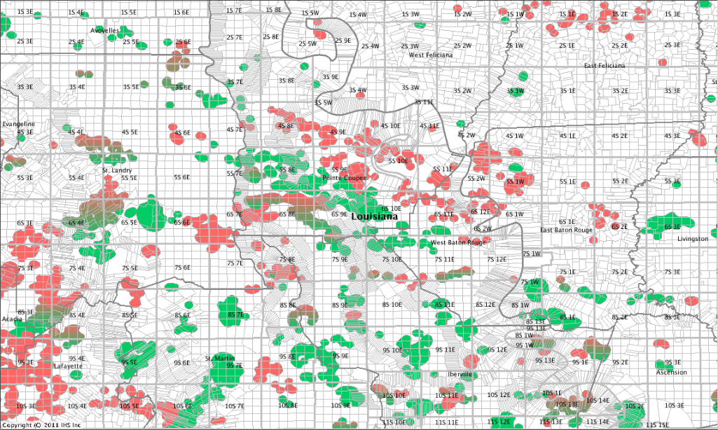
Wx: Eastern La Completion
11-1-2012
1S-2E-74
Petro Guard – Haas 1
Report'd: 3/1/12
IP: 90 BOPD, 27 MCFD
TD: 9,000
Obj/ Perf: 8786-8790
17009206390000
Devon – Soterra 6 H - 1
Report'd: 2/7/12
IP: 35 BOPD, 267 BWPD
TD: V-13000’ , H-15850’
Obj/ Perf: Tusc/ 13108-16829
17105200390000
Devon – Richland Farms 74H-1
Report'd: 5/8/12
IP: 259 BOPD, 151 MCFD
TD: V-13,900 H-19,000
Obj/ Perf: Tusc/ 13718-18146’
17037201540000
Hilcorp – Howard 1
Report'd: 9/21/2012
IP: Future Utility
TD:18400
Obj/ Perf: Tusc/ 18048-18094
17077203980000
Hilcorp– Lind-Dan 1
Report'd: 10/9/2012
IP: 1918 MCFD
TD: 19191
Obj/ Perf: Tusc/ 17449-17634
17033202500000
Pointe Coupee Energy– Thom Trust 1
Report'd: 4/23/12
IP: Dry and Plugged
TD: 8,300
Obj/ Perf: Frio/ N/A
17077206110000
Pennington – Lichtenberg 3 ALT
Report'd: 10/19/2012
IP: 1698 MCFD
TD: 22253
Obj/ Perf: Tusc/ 19240-19260
17077205710000
Neumin Prod– Chenevert 1
Report'd: 5/8/12
IP: Future Utility
TD:12,500
Obj/ Perf: Mid Wx/ N/A
17077206070000
Devon – Lane 64
Report'd: 4/25/12
IP: 13 BOPD 8 MCFD
TD: V-13,900 H-19,000
Obj/ Perf: Tusc/ 15120-15130
17037201490000
Atinum Operating – Indigo 16-1
Report'd: 1/3/12
IP: Casing Collapsed – Possible Redrill
TD: 22,671
Obj/ Perf: Aus Chlk/ N/A
17097210750000
Hilcorp – 15421-1
Report'd: 9/7/2012
IP: Future Utility
TD:21200
Obj/ Perf: Tusc/ 19542-19556
17097209820000
Hilcorp– Parlange 14-Alt
Report'd: 1/4/12
IP: 1 BCPD, 4013 MCFD
TD: 22,580
Obj/ Perf: Tusc/ 20372-20460
17077205890000
Hilcorp– Barber 1
Report'd: 10/24/2012
IP: 155 BCPD, 12229 MCFD
TD: 19278
Obj/ Perf: Tusc/ 18545-18794
17033203000000
Kash Oil – Bacque etal 2
Report'd: 8/27/2012
IP: Unsuccessful
TD: 10290
Obj/ Perf: Frio?/ 6450-6465
Report'd: 10/8/2012
IP: Unsuccessful
Obj/ Perf: Frio?/ 6362-6368
Report'd: 11/1/2012
IP: 125 MCFD
Obj/ Perf: Frio?/ 6322-6328
17097210460000
Neumin Prod– Sidney Dreyfus 1
Report'd: 5/8/12
IP: Future Utility
TD: 12,500
Obj/ Perf: Mid Wx/ N/A
17077206060000
Neumin Prod – Kimball Jr #1
Report'd: 2/15/12
IP: Shut-in Dry Hole
TD: 15,000
Obj/ Perf: Mid Wx/ N/A
17121202190000
Park – Wilbert Sons 17-1
Report'd: 4/24/2012
IP: 26 BOPD 71 MCFD
TD: 10,572
Obj/ Perf: 10482-10502
1712120199
Pay Oil– Garland-12
Report'd: 1/10/12
IP: 8 BOPD 90 BWPD
TD: 1,650
Obj: Miocene Red PMP
Perf: 1630-1640
17097210330000
Liberty– Exxon Fee S 1
Report'd: 2/15/12
IP: 20 BOPD, 0 MCFD
TD: 9,900
Obj/ Perf: 9780-9808
17077200220000
LLOG – Crumholt 1
Report'd: 6/5/2012
IP: Future Utility
TD: 19,500
Obj/ Perf: Tusc/ N/A
1703320301000
Smith – Wilbert sons
Report'd: 9/7/2012
IP: 26 BOPD 71 MCFD
TD: 10354
Obj/ Perf: 8899-8903
Report'd: 3/6/2012
IP: 13 BCPD, 596 MCFD
Obj/ Perf: 9162-9167
Report'd: 10/19/2012
IP: 38 BOPD, 749 MCFD
Obj/ Perf: Marg 3Sd/ 8770-8776
17121201970000
Kash – Sanders 1
Report'd: 9/25/2012
IP: 32 BOPD, 0 MCFD
TD:4520
Obj/ Perf: Miocene?/ 2772-2778
17097210810000
Neumin Prod – Helouin 1
Report'd: 7/25/12
IP: Future Utility
TD: 11650
Obj/ Perf: N/A
17017206100000
R & D Exploration – Kennison #1
Report'd: 1/4/12
IP: Future Utility
TD: 18,100
Obj/ Perf: Wilcox/ N/A
Park Exp – Dupont 96-2
Report'd: 7/25/12
IP: Future Utility
TD: 12316
Obj/ Perf: N/A
17121202220000
BOPCO – Schwing Manag. 1
Report'd: 7/30/12
IP: Future Utility
TD: 10305
Obj/ Perf: N/A
17047211070000
Kash Oil – Jac B Guidry 1
Report'd: 8/27/2012
IP: 13 BCPD, 18 MCFD
TD: 8530
Obj/ Perf: ?/ 8112-8131
Report'd: 8/27/2012
IP: Unsuccessful
Obj/ Perf: ?/ 7957-7980
Report'd: 11/1/2012
IP: Future Utility
Obj/ Perf: ?/ 7957-7980
17097210760000
BOPCO – Green etal 1
Report'd: 5/23/12
IP: 14 BOPD
TD: 13,400
Obj/ Perf: 11350-11362
17099216090000
Park Exp– Dupont 96-3
Recomp’d: 7/30/2012
IP: 415 BOPD, 665 MCFD
Obj/ Perf: Cockfield/ 11295-12255
Report'd: 3/28/12
IP: Future Utility
TD: 12,500
Obj/ Perf: Cockfield/N/A
17121202220000
Recent Completions
Completions
Oil Field Not Reported
Gas Field Oil Gas Field
Luca Op- St Martin Land Co 1
Report'd: 7/30/12
IP: Future Utility
TD: 11950
Obj/ Perf: N/A
17099216140000

